Slide 1



e-Hospital4Future - Building future through an innovated and digital skilled hospital
Module 2: Step by step guide to VR/XR
Funded by the European Union. Views and opinions expressed are however those of the author(s) only and do not necessarily reflect those of the European Union or the Health and Digital Executive Agency (HaDEA). Neither the European Union nor the granting authority can be held responsible for them.
1

Slide 2
What didactic forms can you use when creating your own virtual environment or augmented reality environment?
Funded by the European Union. Views and opinions expressed are however those of the author(s) only and do not necessarily reflect those of the European Union or the Health and Digital Executive Agency (HaDEA). Neither the European Union nor the granting authority can be held responsible for them.
2

Slide 3
Why XR in Healthcare?
Interactive Learning
Professionals can practice in interactive virtual environments that simulate real-life medical scenarios.
Students can interact with patients, diagnose diseases, and practice treatments, all without the risks and limitations of real-life training.
Collaborative Learning
Professionals can collaborate in real-time with other students, mentors, and professionals from around the world.
In doing so, they can seamlessly learn from and support each other.
Adaptive Learning
The training can be tailored to the needs and preferences of each professional.
It offers personalized content that matches their knowledge level and learning strategy.
Notes:
7

Slide 4
Current taxonomy
360° VIDEO

Slide 5
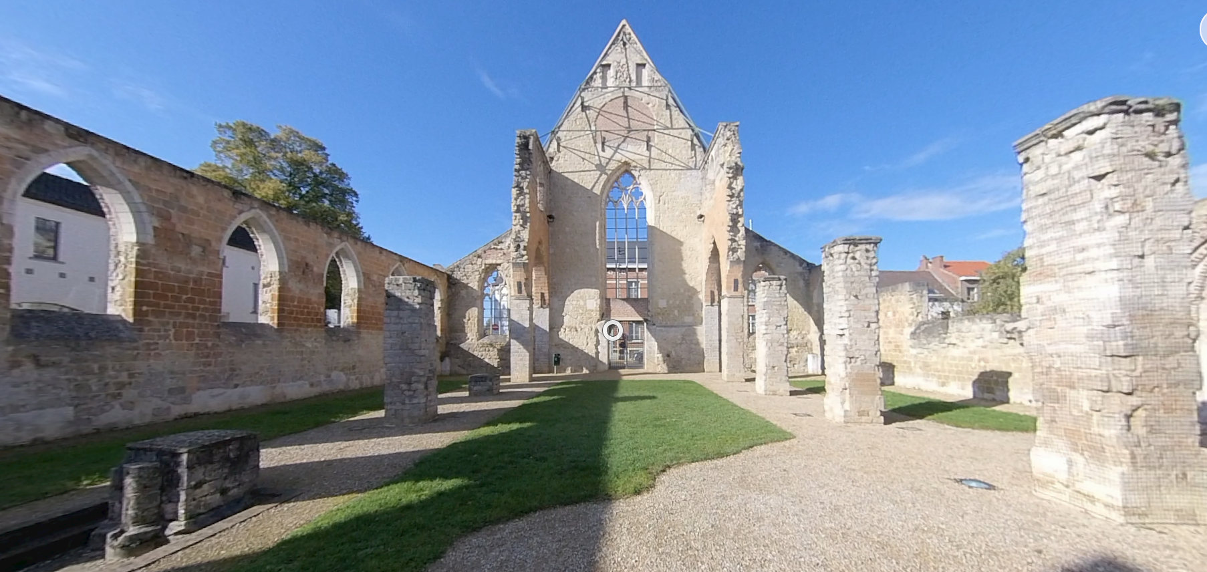
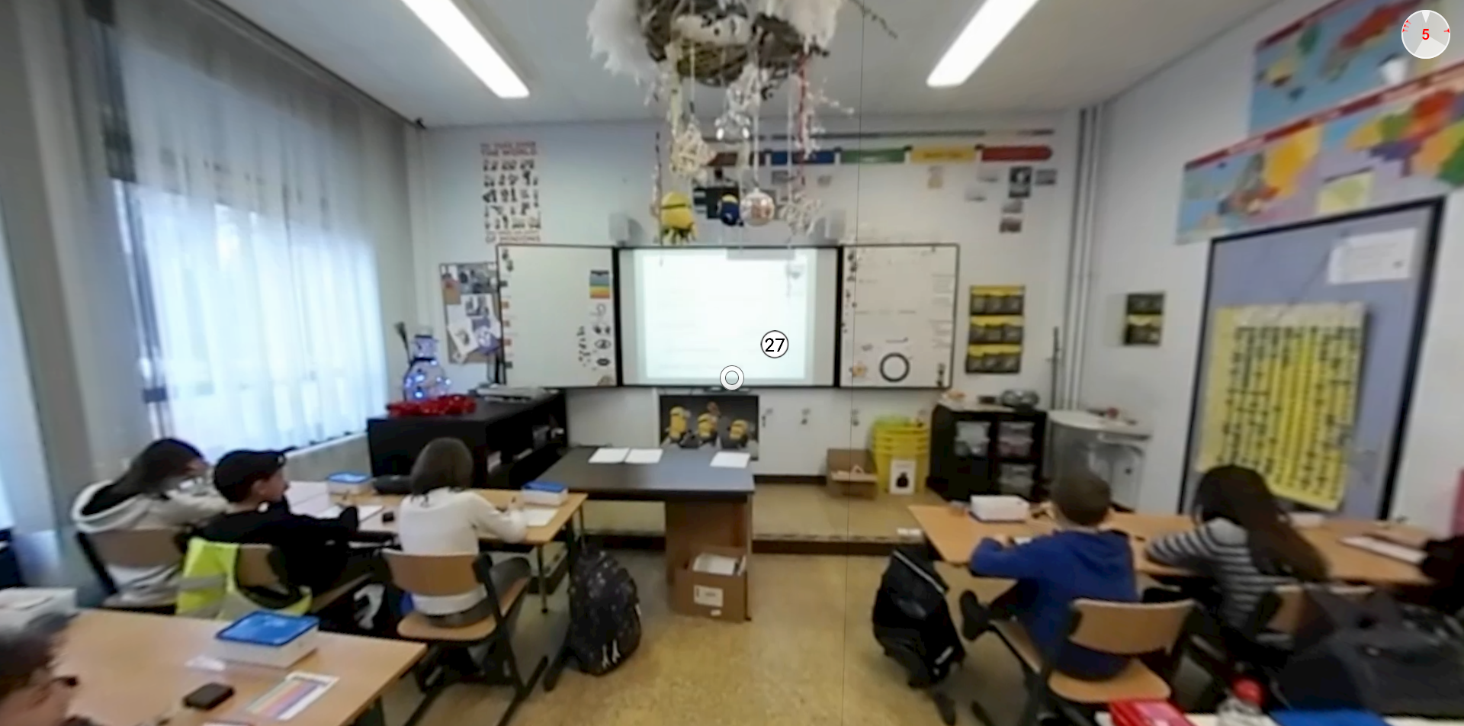
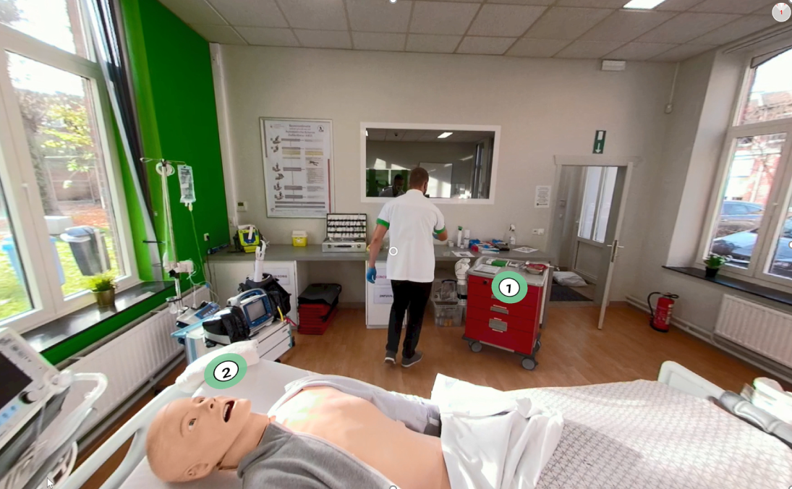

Slide 6


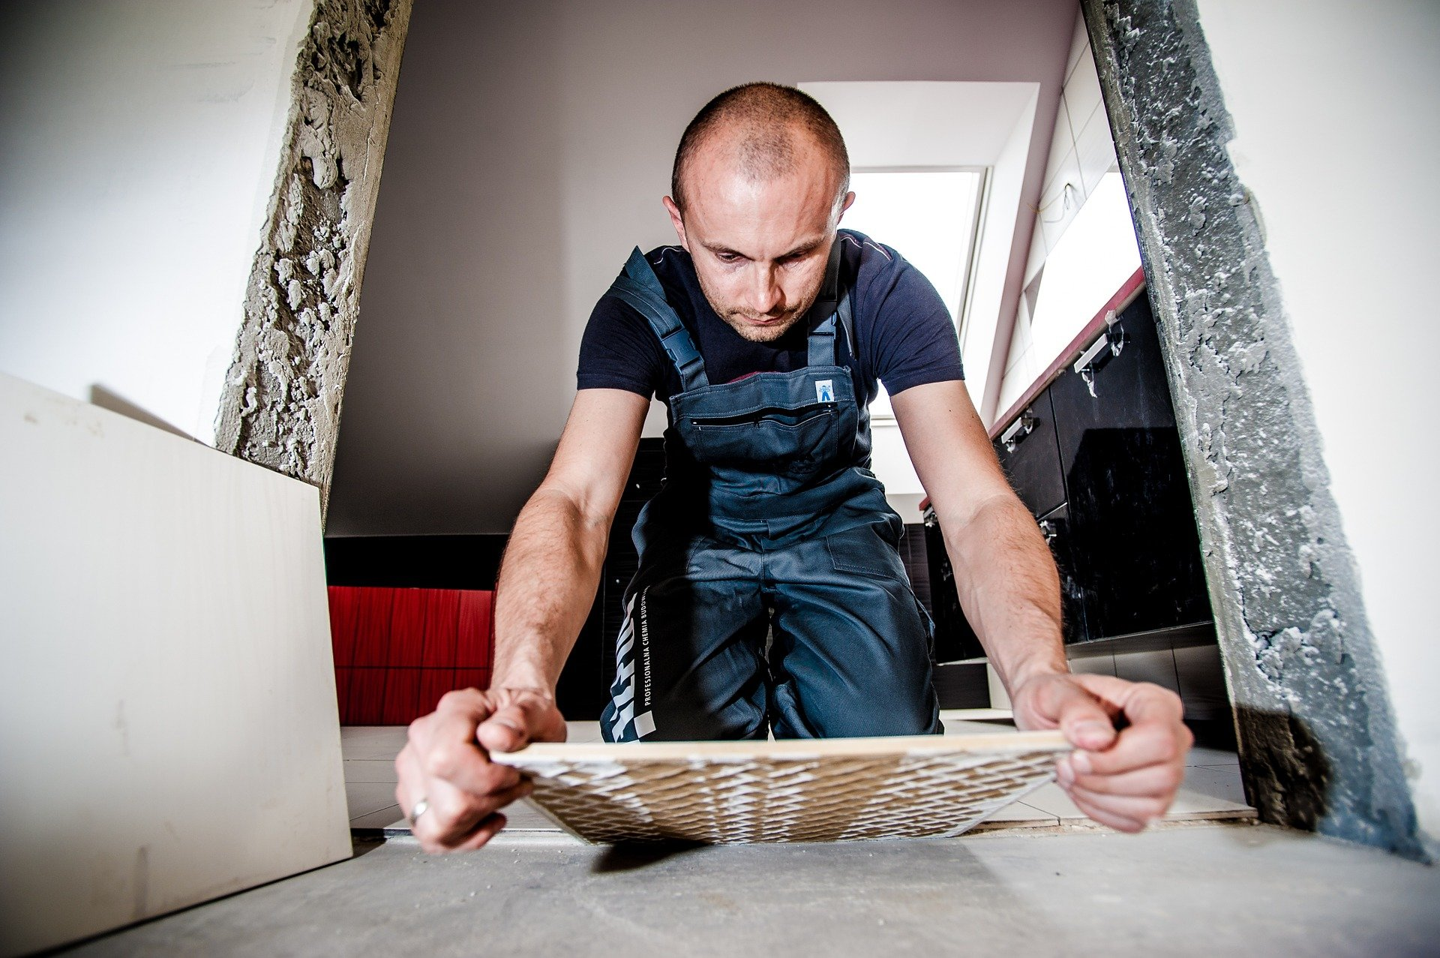
Goal: Bridging the gap between school and real-world
‘Environment’ examples
‘Situation’ examples
‘Demonstration’ examples
World War II places: at the centre of significant events
Operating theatre
Recordings of art works at museums
Driving behaviour: safe & risky comparison
Bullying behaviour observation from the perspective of the victim
Observation of patient with high frequency hearing loss
Explore a construction site in which people are working
Craft skills from 1st person perspective
Surgical techniques
Trauma patient being treated at the emergency department of a hospital

Slide 7



Slide 8
Classification

Slide 9
Classification
E1
E1
E1
S1
S1
S1
D1
D1
D1

Slide 10
Towards design guidelines:
‘Level 1’ is suitable for….
First orientation towards an unfamiliar environment
Taking an oral exam
Active / Collaborative tasks for students: which add-ons would you include in this video?

Slide 11
Towards design guidelines:
‘Level 2’ is suitable for…
Explaining an environment or a situation happening
Including dual-coding theory (Paivio, 1971)
  Add a narrator (audio)
  Combined with the visual environment (video)

Slide 12
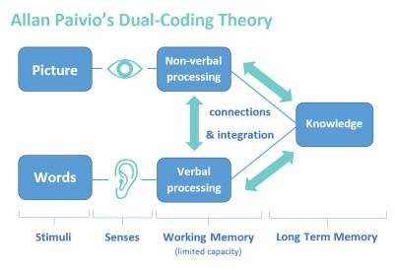
Towards design guidelines:
‘Level 2’ is suitable for…
Explaining an environment or a situation happening
Including dual-coding theory (Paivio, 1971)
  Add a narrator (audio)
  Combined with the visual environment (video)

Slide 13
Towards design guidelines:
‘Level 3’ is suitable for….
Novice learners need a step-by-step guidance
Concern: don’t overload them with add-ons (cognitive load)

Slide 14
Classification
INSTRUCTION
QUIZ/TEST
REALTIME INFORMATION

Slide 15
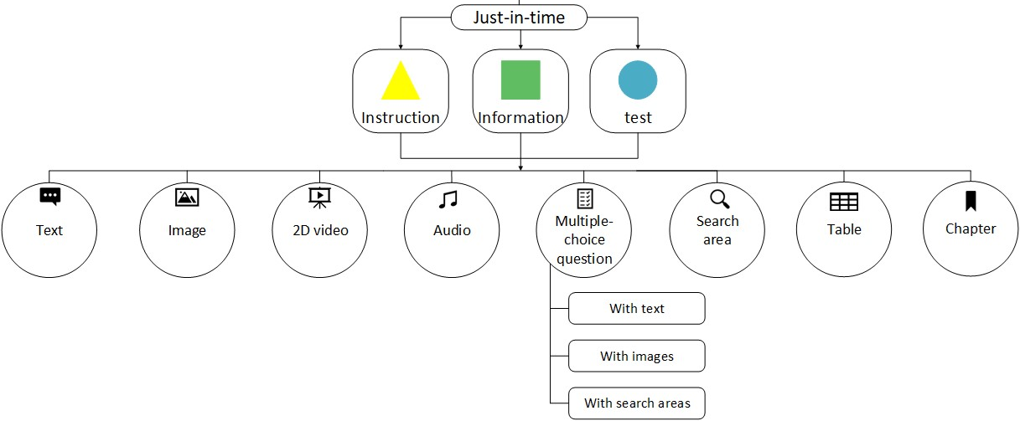
REALISTC VIRTUAL REALITY

Slide 16
What hardware and software can you combine to create your own virtual environment or augmented reality environment
Funded by the European Union. Views and opinions expressed are however those of the author(s) only and do not necessarily reflect those of the European Union or the Health and Digital Executive Agency (HaDEA). Neither the European Union nor the granting authority can be held responsible for them.
16

Slide 17

THINGLINK

Slide 18


THINGLINK

Slide 19
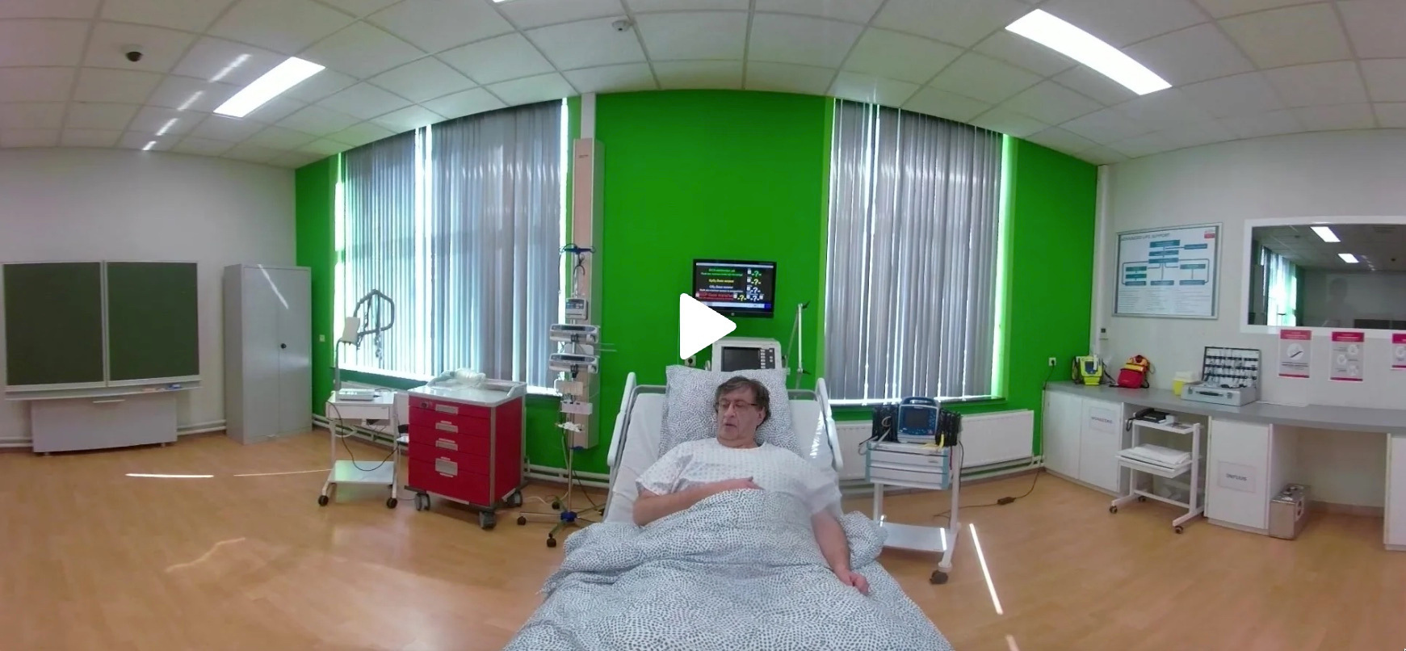
THINGLINK

Slide 20
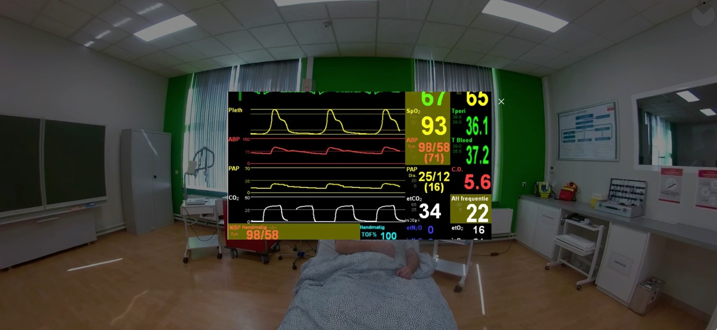
THINGLINK

Slide 21


Slide 22


Slide 23
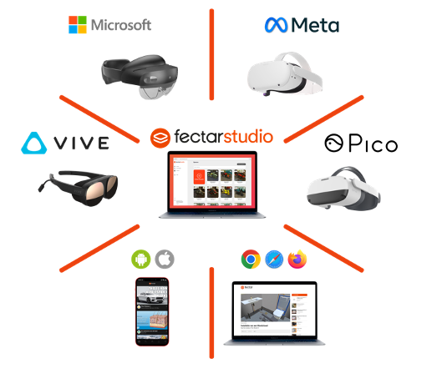

Slide 24
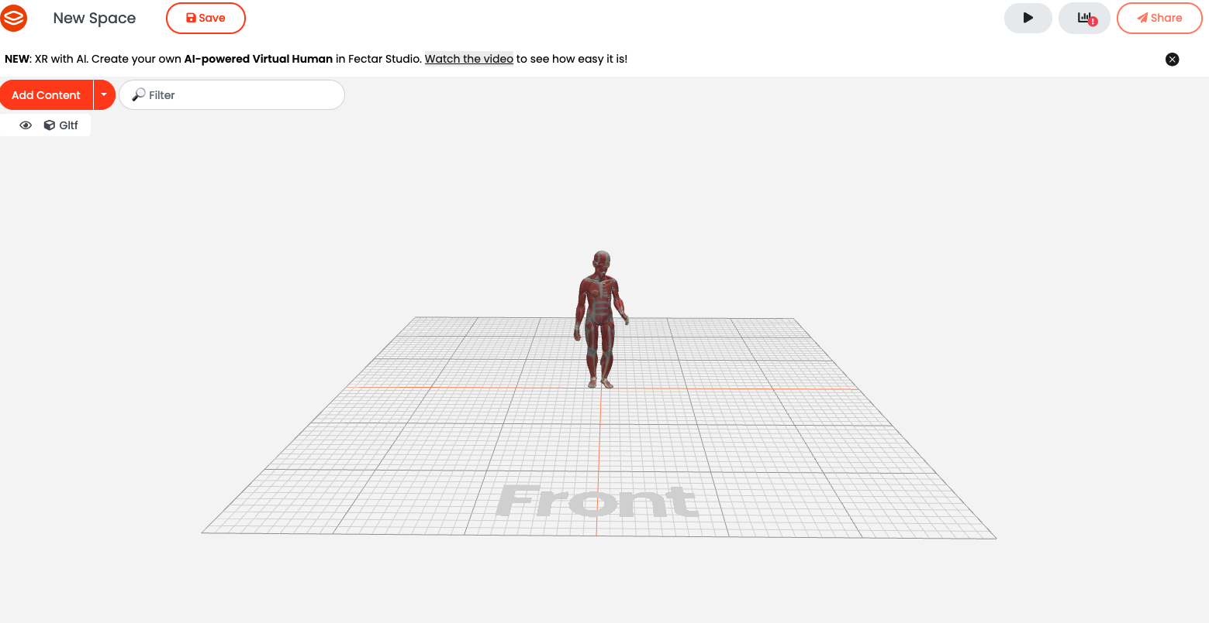

Slide 25


e-Hospital4Future - Building future through an innovated and digital skilled hospital
Thank you!
@e-Hospital4Future
/e-Hospital4Future
https://eh4future.eu/
Funded by the European Union. Views and opinions expressed are however those of the author(s) only and do not necessarily reflect those of the European Union or the Health and Digital Executive Agency (HaDEA). Neither the European Union nor the granting authority can be held responsible for them.

