Slide 1



e-Hospital4Future - Building future through an innovated and digital skilled hospital
Module 1: What does mixed reality in healthcare mean?
Funded by the European Union. Views and opinions expressed are however those of the author(s) only and do not necessarily reflect those of the European Union or the Health and Digital Executive Agency (HaDEA). Neither the European Union nor the granting authority can be held responsible for them.
1

Slide 2
What is the difference between XR, VR, AR and MX?
Funded by the European Union. Views and opinions expressed are however those of the author(s) only and do not necessarily reflect those of the European Union or the Health and Digital Executive Agency (HaDEA). Neither the European Union nor the granting authority can be held responsible for them.
2

Slide 3
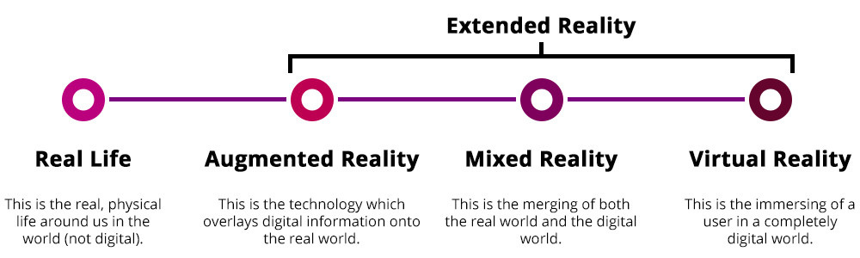
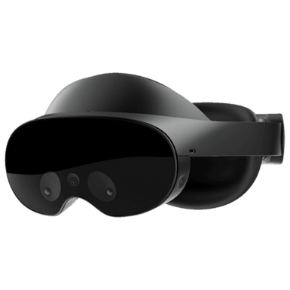

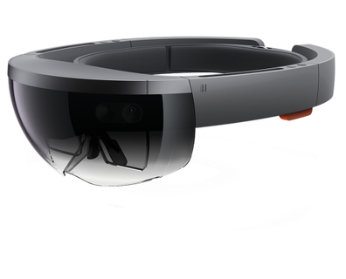
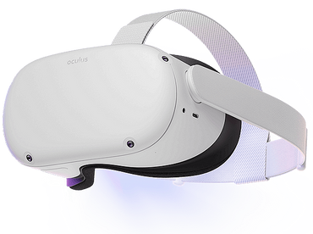
What is XR?
Notes:
5

Slide 4
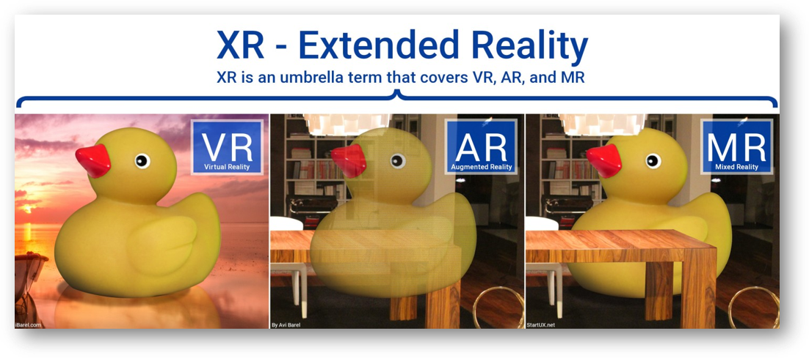
What is XR?
Notes:
6

Slide 5
What are examples of the different concepts?
Funded by the European Union. Views and opinions expressed are however those of the author(s) only and do not necessarily reflect those of the European Union or the Health and Digital Executive Agency (HaDEA). Neither the European Union nor the granting authority can be held responsible for them.
5

Slide 6
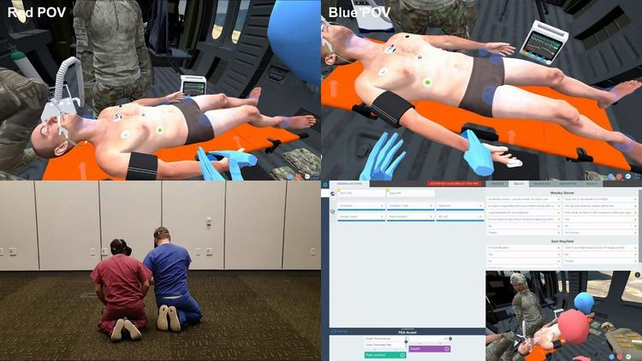
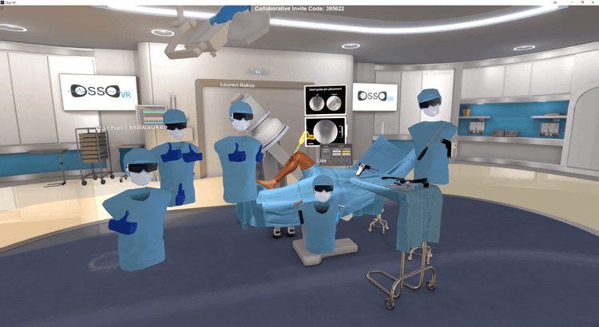
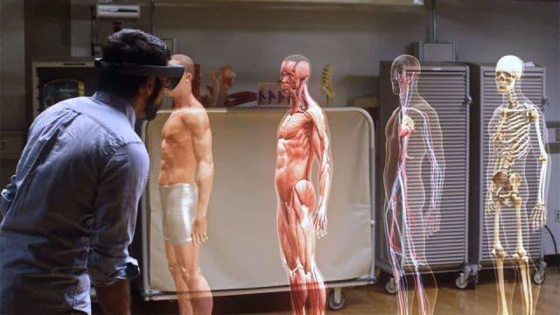
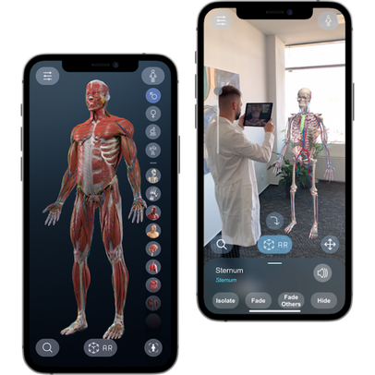
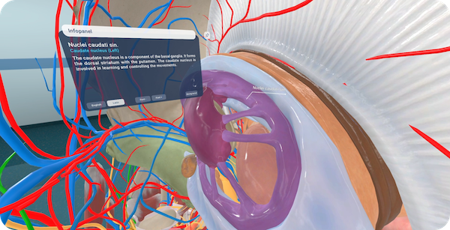
SimX
Osso VR
HoloAnatomy
Virtual Medicine
Notes:
https://onix-systems.com/blog/implementing-virtual-reality-in-medicine-and-medical-training
12

Slide 7


Slide 10
What are the advantages of using XR in learning within healthcare?
Funded by the European Union. Views and opinions expressed are however those of the author(s) only and do not necessarily reflect those of the European Union or the Health and Digital Executive Agency (HaDEA). Neither the European Union nor the granting authority can be held responsible for them.
10

Slide 11
Benefits of Training in XR
XR
Higher motivation and engagement (Botha et al., 2021; Huang et al., 2022, Pellas et al., 2021; Elford et al., 2022; Moro et al., 2020; Reeves et al., 2021; Rodríguez-Abad et al., 2021)
Significantly increased learning performance Memorizing more material and higher exam scores (Di Natale et al., 2020; Elme et al., 2022; Lee et al., 2022; Pellas et al., 2021; Christopoulos et al., 2021; Garzón and Acevedo, 2019; Rodríguez-Abad et al., 2021; Del Cerro Velázquez and Morales Méndez, 2021)
Technical and practical knowledge Analytical thinking and problem-solving skills (Lee et al., 2022; Radianti et al., 2020; Rodríguez-Abad et al., 2021; Yoon & Kang, 2021)
Multiple trainings of complex scenarios at any time and place (Paszkiewicz et al., 2021; Del Cerro Veláquez & Morales Méndez, 2021)
Cost-effective (Di Natale et al., 2020; Mayne & Green, 2020)
Especially beneficial for first-generation students (Miller et al., 2021)
More fun from the lessons (Christopoulos et al., 2021; Yoon & Kang, 2021)
Notes:
9

Slide 12
Why XR in Education? Benefits & Opportunities
Students can easily move to distant or even inaccessible places, in the present, past or future
Students can safely practice dangerous procedures in virtual simulations
A more personalized learning experience is possible
Learners are intrinsically more empowered to learn with these technologies, also due to the use of gamification elements
Freina & Ott, 2015; Kavanagh et al., 2017; Jensen & Konradsen, 2018; Chavez & Bayonna, 2019; Papanastiaou et al., 2019, Maas & Hughes, 2020; Di Natale et al., 2020; Radianti et al., 2020.

Slide 13
Why XR in Education? Benefits & Opportunities
VR leads to better learning outcomes, both for knowledge and skills.
The same is true for Augmented Reality
Various review studies: e.g. Boel et al., 2021; Chavez and Bayonna, 2018; Wu, Yu and Gu, 2020
Papanastiaou et al., 2019; Kaplan, et al., 2020

Slide 14
What are Disadvantages to use XR within healthcare?
Funded by the European Union. Views and opinions expressed are however those of the author(s) only and do not necessarily reflect those of the European Union or the Health and Digital Executive Agency (HaDEA). Neither the European Union nor the granting authority can be held responsible for them.
14

Slide 15
Disadvantages of training in XR
XR
Health Risks and Addiction (Botha et al., 2021; Udeozor et al., 2021; Moro et al., 2020; Paszkiewicz et al., 2021)
Need for trained trainers and students (Radianti et al., 2020; Nørgård et al., 2019)
Novelty effect (Christopoulos et al., 2021; Coban et al., 2022)
Expensive hardware (Radianti et al., 2020)
Can't take into account every variable from real life (Udeozor et al., 2021)
Rather limited range of off-the-shelf training materials (Del Cerro Velázquez & Morales Méndez, 2021)
Notes:
10

Slide 16
What do you need to use XR within healthcare?
Funded by the European Union. Views and opinions expressed are however those of the author(s) only and do not necessarily reflect those of the European Union or the Health and Digital Executive Agency (HaDEA). Neither the European Union nor the granting authority can be held responsible for them.
16

Slide 17
Why XR in Education? Benefits & Opportunities
A need for XR learning materials whose educational design is evidence-based
A need for XR learning materials that are better aligned with contextual learning objectives
Teachers indicate that they need training to be able to use these new technologies efficiently.
A need for support and professionalization of teachers
  Boel et al., 2021b; Kavanagh et al, 2017; Jensen & Konradsen, 2018; Chavez & Bayonna , 2018

Slide 18
Why XR in Education? Benefits & Opportunities
Applying XR technology requires a high investment cost (hardware, software, infrastructure for premises)
Application of innovative technology requires an integrated approach, with an ICT policy and a clear pedagogical vision
  Boel et al., 2021; Kavanagh et al., 2017; Tondeur et al., 2008; Vanderlinde & van Braak, 2010

Slide 19
Why XR in Education? Benefits & Opportunities
A need for research in authentic learning contexts: the existing research on XR technology mainly takes place in labs and focuses largely on higher education and professional training contexts
A need for high-quality effectiveness measurements:
  Existing research too often focuses on the mere passive 'consumption' of learning content, while these technologies also offer opportunities to construct knowledge themselves in a vision of critical reasoning, problem-solving thinking and computational thinking
  Freina & Ott, 2015; Chavez & Bayonna, 2019; Di Natale et al., 2020; Jensen & Konradsen, 2018; Maas & Hughes, 2020; Di Natale, 2020

Slide 20
3 challenges for future implementation
Design challenge
Storyboard
Open educational resources & practices
Marketplace
Implementation challenges
Wireless headsets & mobile packages of 20 pico
Cloud
Learner engagement challenges
Learning analytics dashboard
Tutoring
Social element, questions, collaboration

Slide 21
What hardware do you need to use XR within healthcare?
Funded by the European Union. Views and opinions expressed are however those of the author(s) only and do not necessarily reflect those of the European Union or the Health and Digital Executive Agency (HaDEA). Neither the European Union nor the granting authority can be held responsible for them.
21

Slide 22


ENVIRONMENT?
OBJECTS?
ENRICH?
PUBLISH?

Slide 23

ENVIRONMENT?

Slide 24
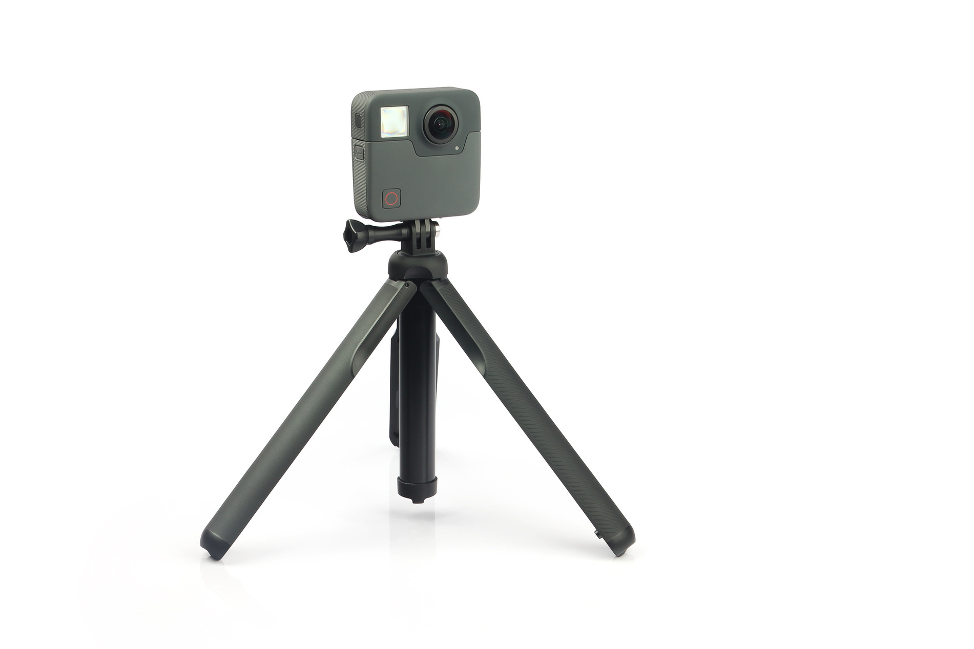

Slide 25

OBJECTS?

Slide 26
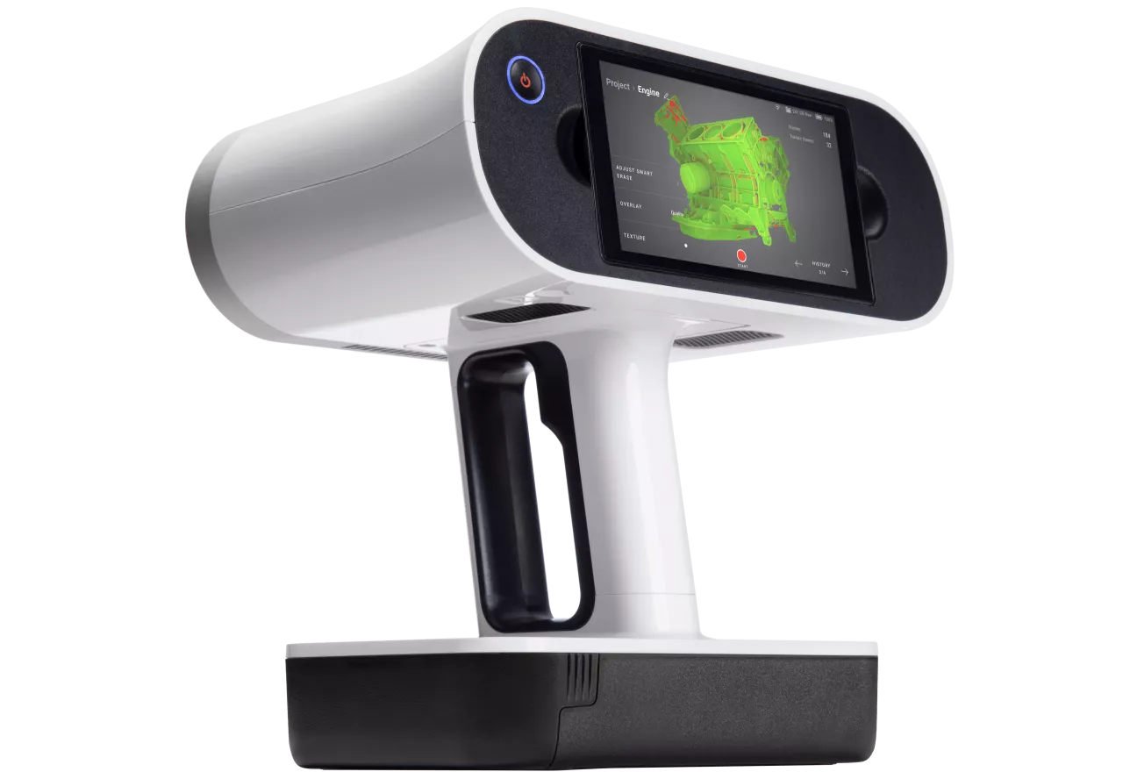

Slide 27
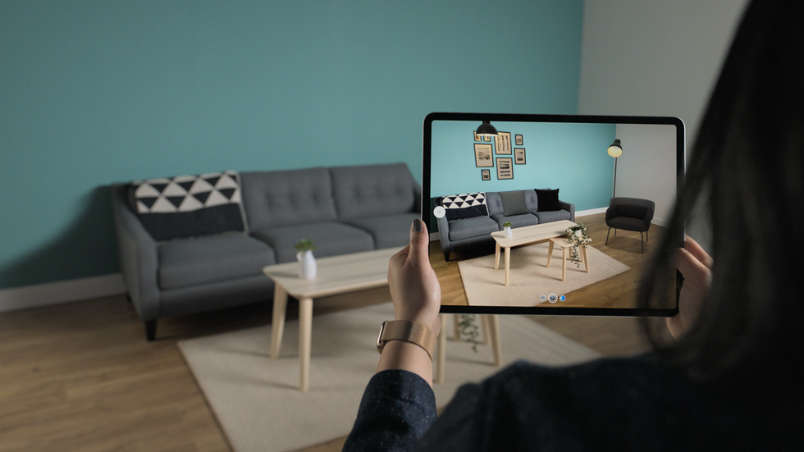


Slide 28
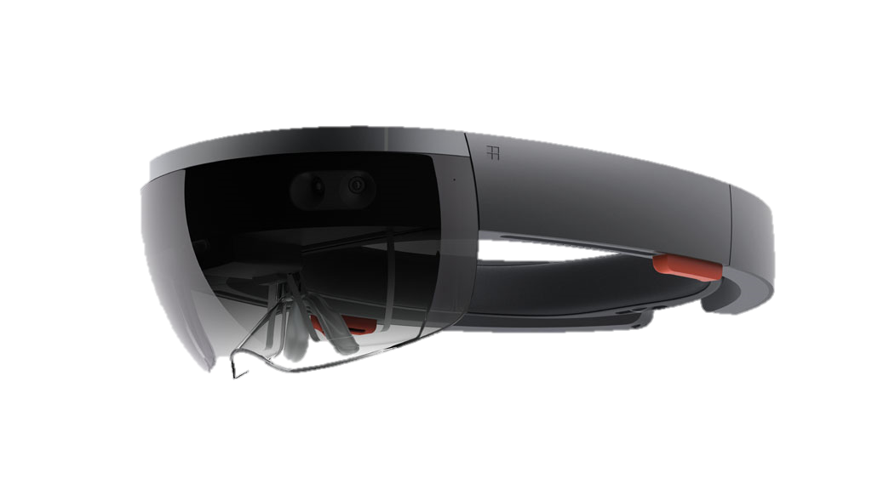

Slide 29
What hardware and software do you need to produce your own XR?
Funded by the European Union. Views and opinions expressed are however those of the author(s) only and do not necessarily reflect those of the European Union or the Health and Digital Executive Agency (HaDEA). Neither the European Union nor the granting authority can be held responsible for them.
29

Slide 30

THINGLINK

Slide 31


THINGLINK

Slide 32


Slide 33
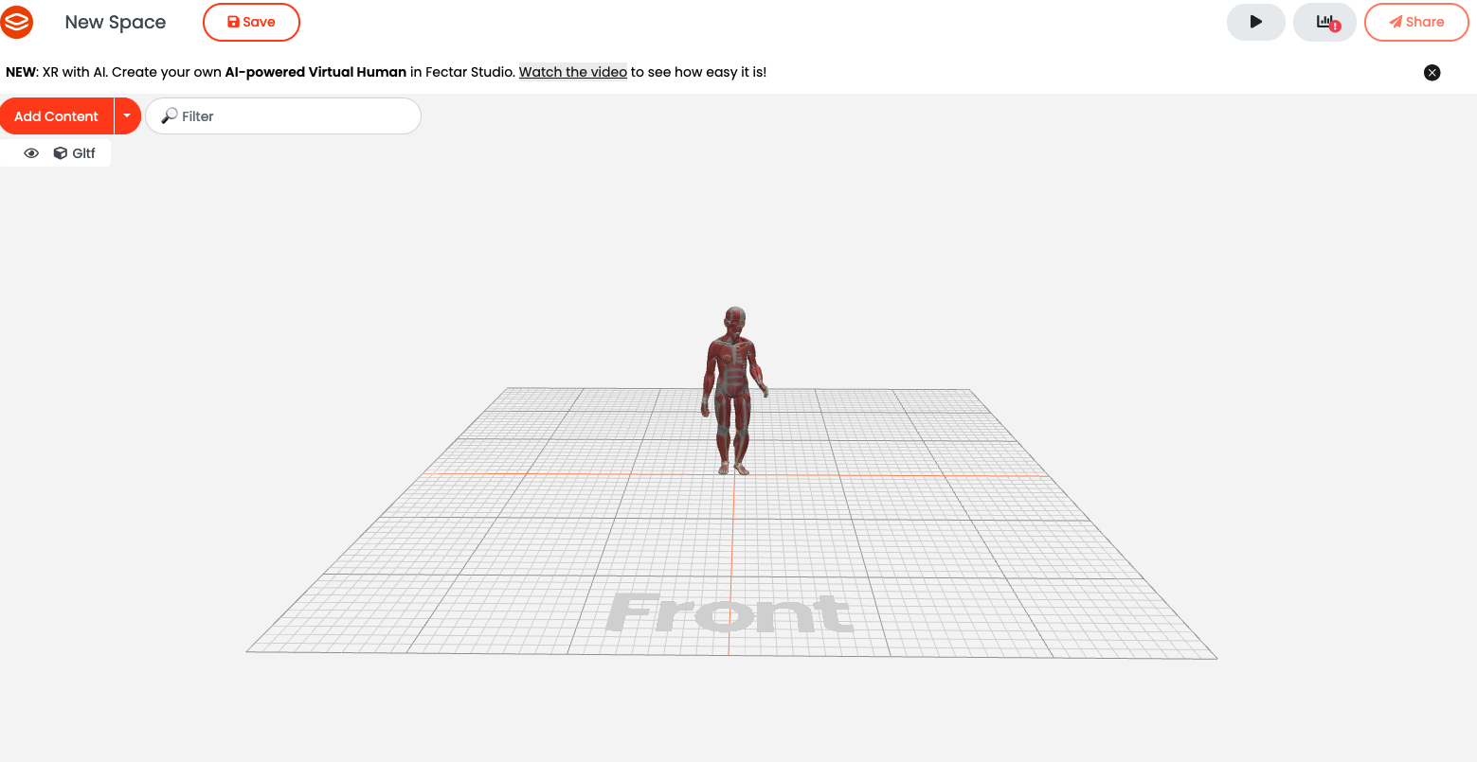

Slide 34

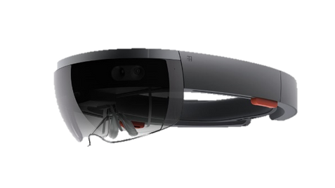

Slide 35
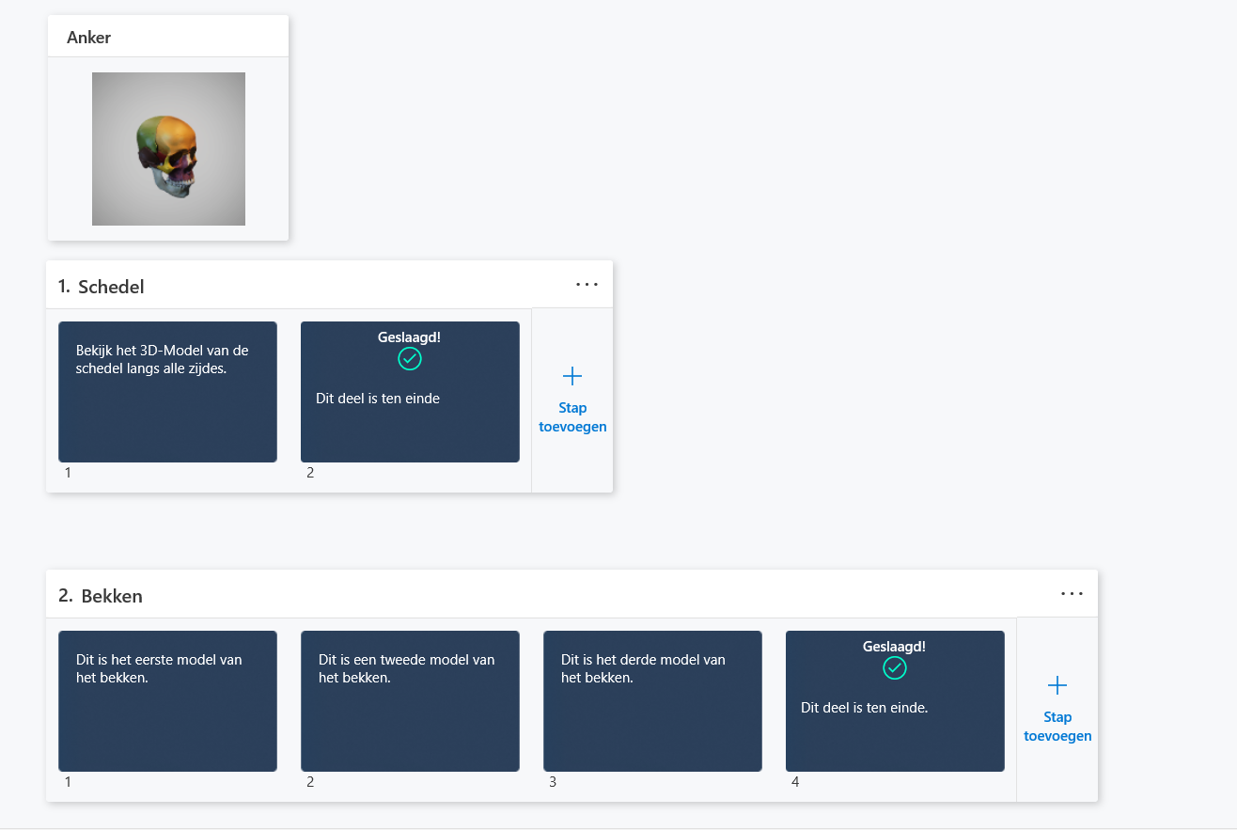


Slide 36


e-Hospital4Future - Building future through an innovated and digital skilled hospital
Thank you!
@e-Hospital4Future
/e-Hospital4Future
https://eh4future.eu/
Funded by the European Union. Views and opinions expressed are however those of the author(s) only and do not necessarily reflect those of the European Union or the Health and Digital Executive Agency (HaDEA). Neither the European Union nor the granting authority can be held responsible for them.

